Slide 1

Database Design & Applications
The Database Language - SQL Aggregation

Slide 2
Aggregating Data Using Group Functions
Objectives
After completing this lesson, you should be able to do the following:
Identify the available group functions
Describe the use of group functions
Group data using the GROUP BY clause
Include or exclude grouped rows by using the
HAVING clause

Slide 3
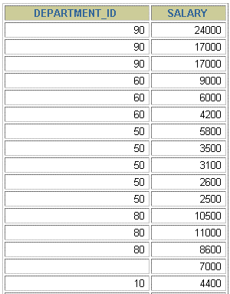

What Are Group Functions?
Group functions operate on sets of rows to give one result per group.
EMPLOYEES
The maximum salary in
the EMPLOYEES
table.
…

Slide 4
Types of Group Functions
AVG
COUNT
MAX
MIN
STDDEV
SUM
VARIANCE

Slide 5
Group Functions Syntax
SELECT |  | [column,] group_function(column), ...
FROM [WHERE [GROUP | BY | table condition] column]
[ORDER | BY | column];

Slide 6
AVG and SUM Functions
You can use AVG and SUM for numeric data.
SELECT AVG(salary), MAX(salary), MIN(salary), SUM(salary)
FROM employees
WHERE job_id LIKE '%REP%';

Slide 7

MIN and MAX Functions
You can use MIN and MAX for any data type.

Slide 8
COUNT Function
COUNT(*) returns the number of rows in a table.
SELECT | COUNT(*)
FROM employees WHERE department_id = 50;

Slide 9
COUNT Function
COUNT(expr) returns the number of rows with non-null values for the expr.
Display the number of department values in the EMPLOYEES table, excluding the null values.
SELECT
FROM employees
WHERE department_id = 80;
COUNT(commission_pct)

Slide 10
DISTINCT Keyword
COUNT(DISTINCT expr) returns the number of distinct non-null values of the expr.
Display the number of distinct department values in the EMPLOYEES table.
SELECT | COUNT(DISTINCT department_id)
FROM employees;

Slide 11
Group Functions and Null Values
Group functions ignore null values in the column.
SELECT
FROM employees;
AVG(commission_pct)

Slide 12
Handling NULLs with Group Functions
The ISNULL function forces group functions to include null values.
SELECT AVG(ISNULL(commission_pct, 0)) FROM employees;

Slide 13
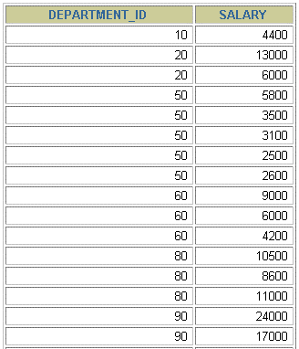
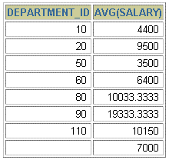
Creating Groups of Data
For each department average salary in EMPLOYEE table
EMPLOYEES
4400
9500
3500
6400
…

Slide 14
GROUP BY Clause
SELECT FROM [WHERE
column, group_function(column) table
condition]
[GROUP BY group_by_expression]
[ORDER BY column];
Divide rows in a table into smaller groups by using the
GROUP BY clause.

Slide 15
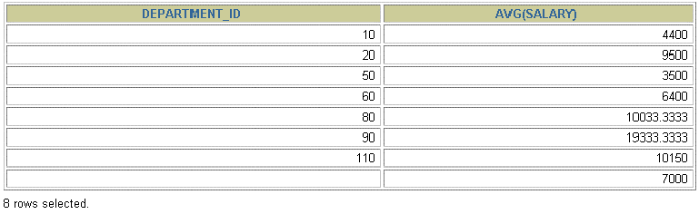
GROUP BY Clause
All columns in the SELECT list that are not in group functions must be in the GROUP BY clause.
SELECT department_id, AVG(salary) FROM employees
 | GROUP BY department_id | ;

Slide 16
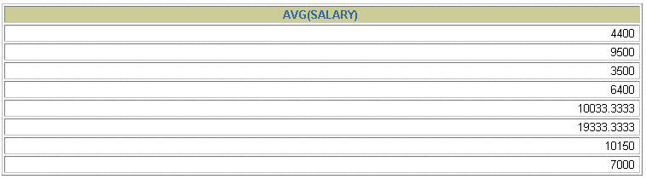
GROUP BY Clause
The GROUP BY column does not have to be in the SELECT list.
SELECT AVG(salary) FROM employees
 | GROUP BY department_id | ;

Slide 17
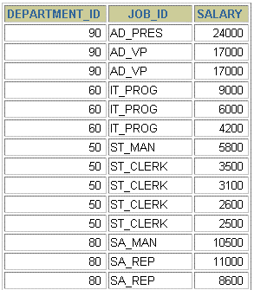
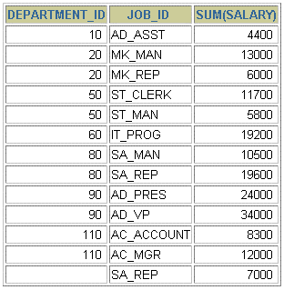

Grouping by More Than One Column
EMPLOYEES
Add up the
salaries in
the
EMPLOYEES
table for each job, grouped by
department.
…

Slide 18
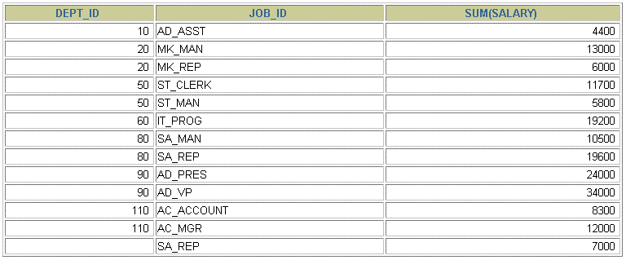
Grouping by More Than One Column
SELECT FROM
department_id dept_id, job_id, SUM(salary) employees
;
GROUP BY department_id, job_id

Slide 19
Illegal Queries Using Group Functions
Any column or expression in the SELECT list that is not an aggregate function must be in the GROUP BY clause.
SELECT department_id, COUNT(last_name) FROM employees;
ERROR:
Column 'EMPLOYEES.department_id' is invalid in the select list because it is not contained in either an aggregate function or the GROUP BY clause.

Slide 20
Illegal Queries Using Group Functions
You cannot use the WHERE clause to restrict groups.
You use the HAVING clause to restrict groups.
You cannot use group functions in the WHERE clause.
SELECT FROM WHERE
department_id, AVG(salary) employees
AVG(salary) > 8000
GROUP BY department_id;
WHERE AVG(salary) > 8000
ERROR at line 3:
^{Cannot} use the WHERE clause to restrict groups

Slide 21
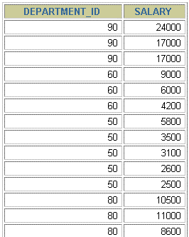
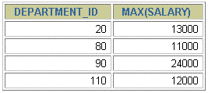

Excluding Group Results
EMPLOYEES
The maximum salary
per department when it is greater than
$10,000
…

Slide 22
Using HAVING Clause
Use the HAVING clause to restrict groups:
Rows are grouped.
The group function is applied.
Groups matching the HAVING clause are displayed.
SELECT FROM [WHERE [GROUP BY
column, group_function table
condition] group_by_expression
[HAVING
group_condition]
[ORDER BY
column];

Slide 23
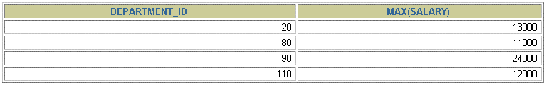
Using HAVING Clause
SELECT department_id, MAX(salary) FROM employees GROUP BY department_id
 | HAVING MAX(salary)>10000 | ;

Slide 24

Using HAVING Clause
SELECT FROM WHERE
job_id, SUM(salary) PAYROLL employees
job_id NOT LIKE '%REP%'
GROUP BY job_id
HAVING SUM(salary) > 13000
ORDER BY SUM(salary);

Slide 25
THANK YOU!

